Slide 1

AI-Based UFDR Analysis Tool
Universal Forensic Extraction Device Report Analysis Platform
ROHIT L - 192511236 VISHNU B - 192512410
FACULTY INCHARGE Dr. VEERAMANI

Slide 2

The Problem
Data Overload
Fragmented Evidence
Digital investigations generate massive forensic reports that are slow and time-consuming to analyze manually.
Investigators must examine chats, calls, images, GPS data, and documents separately.
Missed Evidence
Important evidence can be overlooked due to the sheer volume of data.

Slide 3





Our Objective
Develop an intelligent forensic investigation platform that assists investigators by:
Organize Evidence
Identify Relationships
Automatically structure extracted digital evidence for easy access.
Map connections between contacts, calls, and communications.
Reconstruct Timelines
Flag Suspicious Activity
Build chronological event sequences from raw forensic data.
Highlight anomalies and generate investigation summaries.

Slide 4
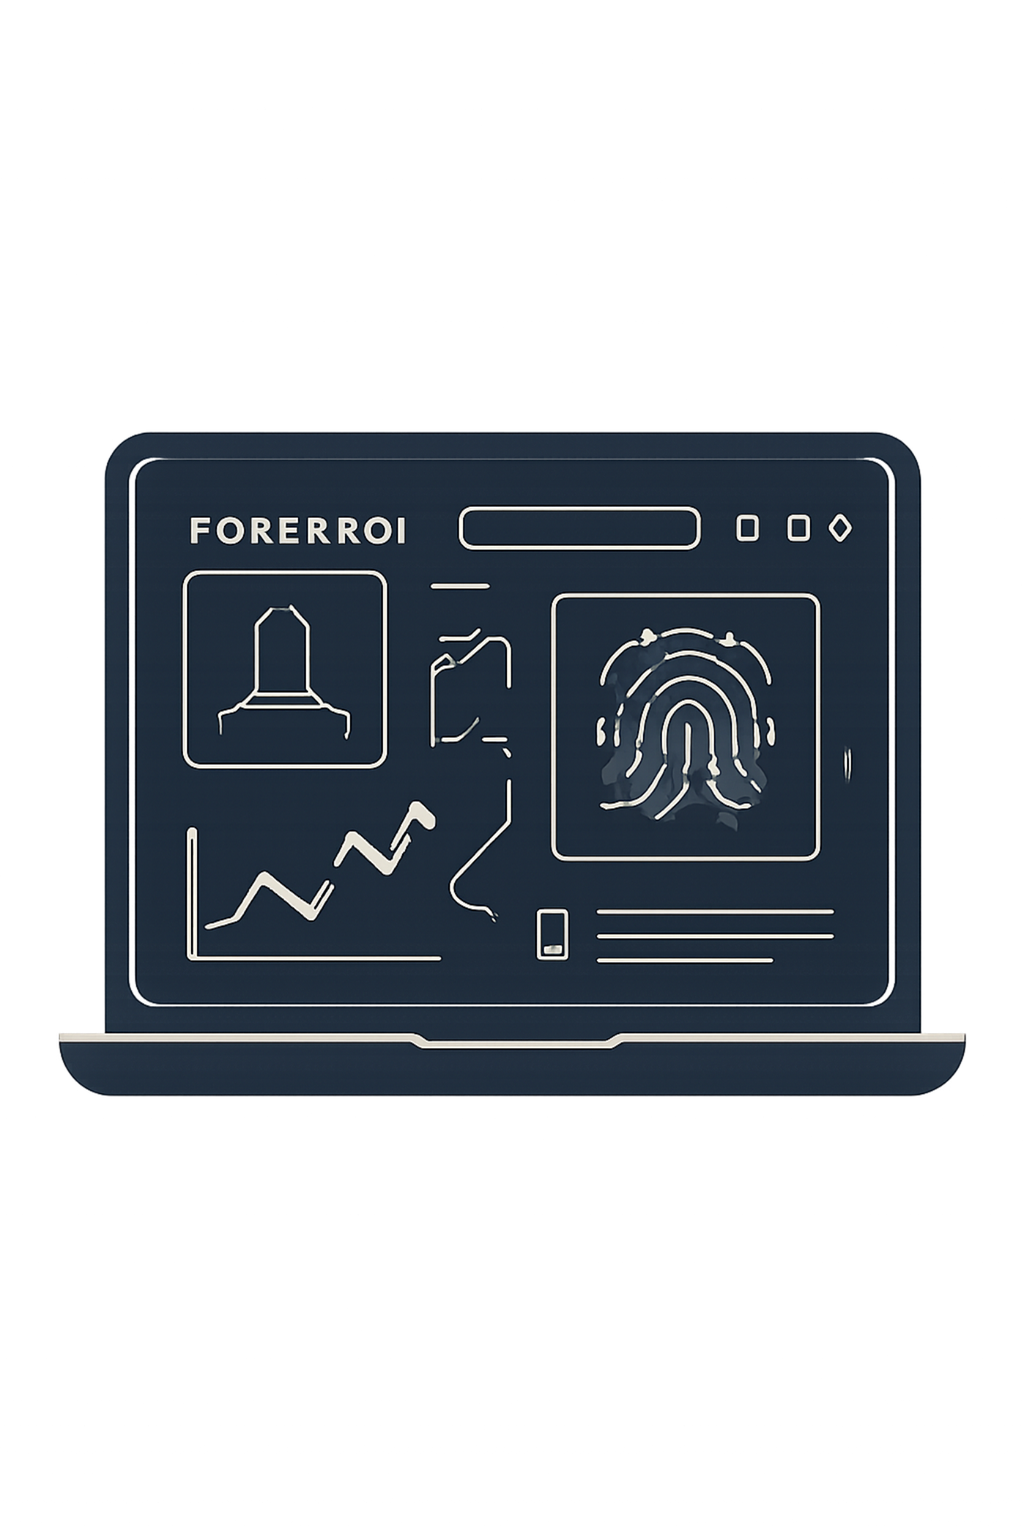

Proposed Solution
Upload UFDR Reports
Import forensic data in a single step.
Auto-Organize Evidence
Classify messages, calls, images, GPS, and documents automatically.
Search & Visualize
Cross-reference all evidence sources and visualize relationships.
Generate Reports
Produce structured investigation summaries instantly.

Slide 5


Technology Stack
Why This Stack?
Each technology was chosen for speed, scalability, and forensic data handling.
React + Tailwind CSS
FastAPI + PostgreSQL
Responsive, modern UI for investigators.
High-performance backend with robust data storage.
Cytoscape.js + Leaflet
Relationship graphs and GPS map visualization.

Slide 6
MODULE 1
Convert the UFDR forensic file into structured, searchable evidence.
UFDR File Extraction – Extract forensic data from UFDR files.
Evidence Categorization – Organize calls, messages, contacts, media, locations, etc.
Data Search & Filtering – Quickly search and filter extracted evidence.
Timeline Generation – Create a chronological timeline of device activities.
Evidence Integrity – Maintain metadata, timestamps, hashes, and forensic evidence integrity.
UFDR File
↓
Extraction Engine
↓
Evidence Parser
↓
Structured Evidence Database
↓
Search / Timeline / Evidence Viewer

Slide 7
MODULE 2
AI-Based Investigation & Intelligence
AI Evidence Analysis – Analyze extracted forensic data using AI.
Entity & Relationship Detection – Identify people, phone numbers, locations, and their connections.
Suspicious Activity Detection – Detect unusual communication and activity patterns.
AI Summarization & Querying – Ask questions in natural language and generate evidence-based summaries.
Investigation Report Generation – Generate structured investigation reports with relevant findings.
Structured Evidence
↓
AI Engine
↓
┌───────┼────────┐
↓ ↓ ↓
Entities Patterns Relationships
↓
Investigation
↓
AI Insights/Report

Slide 8
System Workflow
01
02
03
Upload UFDR
Evidence Processing & Classification
Timeline Generation
Import the forensic report into the platform.
Build a chronological event sequence from the evidence.
Automatically categorize all extracted data types.
04
05
Relationship Analysis
Case Dashboard & Investigation Report
Map connections between contacts and communications.
Review all findings and generate the final summary.
A streamlined pipeline takes investigators from raw UFDR data to a complete, actionable case report.

Slide 9







Evidence Dashboard
All evidence types unified in one centralized view.
Messages
Call Logs
Contacts
Images & Videos
GPS History
Documents
Browser History

Slide 10


Investigation Dashboard
Timeline View
Relationship Graph
Location Map
GPS history plotted geographically.
Chronological event reconstruction.
Visual network of contacts and communications.
Communication Stats
Keyword Search
Call and message frequency analysis.
Instant search across all evidence sources.

Slide 11
AI-Powered Investigation Assistant
Ask natural language questions to instantly query forensic data.
Show all conversations with Rahul.
List calls made after 10 PM.
Display all visited locations.
Generate a case summary.
Find the most contacted number.

Slide 12

Advantages & What's Next
Key Advantages
Future Enhancements
Faster evidence organization
Improved investigation workflow
Better visualization of data
Reduced manual effort
Centralized case management
Easy report generation
Multi-device correlation
Face recognition & voice transcription
Multilingual analysis
Offline deployment
Advanced document intelligence
Court-ready reporting
Demo Tip: Use a realistic mock case (e.g., "Operation Phoenix") with sample chats, call logs, GPS history, and photos to demonstrate the full investigation flow.

